Slide 1
Title VI: Expectations and Responsibilities
Kentucky Transportation Cabinet
Office for Civil Rights and Small Business Development
200 Mero Street Frankfort, KY 40622 v Phone: (502) 564-3601 v Fax: (502) 564-1491

Slide 2
Objectives
Understand Title VI Authorities/Law
Understand compliance with Title VI
Discuss Components of a Title VI Implementation/Program Plan
Notes:
Implementation Plan and Program Plan are interchangeable some states use Implementation and some use Program, we use Implementation Plan

Slide 3
What is Title VI
Federal Law
The Civil Rights Act of 1964
“No person in the United States shall on the ground of race, color, or national origin be excluded from participation in, be denied the benefits of, or be subjected to discrimination under any program or activity receiving Federal financial assistance.” (42 U.S.C. 2000d)

Slide 4
Who is Protected?
Title VI applies to all “persons.”
Courts have interpreted the Equal Protection Clause of the Fourteenth Amendment and analogous language in civil rights laws to mean that Title VI protects all persons in the United States.
Applies to direct and indirect effects on those persons.

Slide 5
Federal Aid Highway Act
Section 162(a) of the Federal-Aid Highway Act of 1973 (23 U.S.C. 324)
The FHWA regulations at 23 CFR 200.5(p) refer to the FHWA Title VI Program that covers Title VI requirements and requirements of other civil rights provisions “to the extent that they prohibit discrimination on the grounds of race, color, sex, or national origin in programs receiving Federal financial assistance of the type subject to Title VI itself.”

Slide 6
Title VI Protected Classes
Race
Color
National Origin
Sex

Slide 7
Nondiscrimination Laws and Executive Orders
Civil Rights Act of 1964*
Federal Aid Highway Act (1973)
Civil Rights Restoration Act (1987)
Rehabilitation Act (1973)
American with Disabilities Act (1991)
Age Discrimination Act (1975)
Executive Order – 13166: Limited English Proficiency (LEP)
Executive Order – 12898: Environmental Justice (EJ)
Notes:
The 1970 Uniform Act (42 U.S.C. 4601) prohibits unfair and inequitable treatment of persons who have been displaced or whose property will be acquired as a result of federally assisted programs or activities.
Section 162(a) of the Federal-Aid Highway Act of 1973 (Section 324,Title 23 U.S.C.) prohibits discrimination based on sex (gender).
Section 504 of the Rehabilitation Act of 1973 prohibits discrimination based on a disability.
The Age Discrimination Act of 1975 (Section 6101-6107, Title 42 U.S.C.) prohibits discrimination based on age.
The Civil Rights Restoration Act of 1987, P.L. 100-209 clarifies the intent of Title VI to include all programs and activities of entities whether those programs and activities are federally funded or not.
23 CFR Part 200, the Federal Highway Administration’s Title VI Program Implementation and Review Procedures.
49 CFR Part 21, the U.S. Department of Transportation’s Implementing Regulations of Title VI of the Civil Rights Act of 1964.
Executive Order 12898, Federal Actions to Address Environmental Justice in Minority Populations and Low-Income Populations, addresses disproportionate adverse environmental, social and economic impacts that may exist in communities, specifically minority and low-income populations.
Executive Order 13166, Improving Access to Services for Persons with Limited English Proficiency, addresses access to services for persons whose primary language is not English and who have limited ability to read, write, speak, or understand English.

Slide 8
What is Discrimination?
The act (action or inaction), whether intentional or unintentional, through which a person in the U.S., solely because of distinguishing protected attributes, is subjected to disparate treatment or impact, in any program or activity receiving Federal financial assistance from FHWA Under 23 U.S.C.
Notes:
Audience participation – Ask for examples of discrimination.

Slide 9
Types of Discrimination
Denial of program services, financial aid, or benefits
Providing different types of program services, financial aid
Providing group services in a different manner
Segregating or separately treating individuals or groups in any matter relating to the receipt of any program service, financial aid or benefit
Imposing impacts to groups for the benefit of another group
Notes:
Audience participation ask to provide an example of discrimination

Slide 10
Disparate Treatment
When similarly situated persons are treated differently because of their race, color, national origin, or sex.
Notes:
Discriminatory intent does not have to be the only motive. A violation still occurs when the evidence shows that the entity adopted a policy at issue “because of,” not merely “in spite of,” its adverse effects on an identifiable group.
In order to establish a claim of intentional discrimination, a complainant must show that a particular action was motivated by an intent to discriminate. This usually means presenting evidence of discriminatory statements, and/or a history of discriminatory treatment.

Slide 11
Disparate Impact
Refers to actions in which the recipient in violation of agency regulations, uses a facially neutral procedure or practice that has adverse effects on members of a group based on race, color, national origin, or sex; and such practice lacks a substantial legitimate justification.

Slide 12
Minority & Women Representation on Planning Boards & Commissions
Including minorities and women on planning boards and commissions is key for creating an equal access planning system.
Sub-recipients cannot deny someone the opportunity to participate as a member of a planning or commission board.

Slide 13
Compliance
Who MUST comply?
Recipients of federal financial aid must comply with the various Title VI nondiscrimination laws and regulations.
A recipient is any entity or individual to whom Federal assistance is provided (23 CFR 200.5(n)).
Sub-recipients and contractors, regardless of tier, are REQUIRED to prevent discrimination and ensure nondiscrimination in all of their programs and activities.
Notes:
Federal assistance can be provided directly or indirectly through another recipient for any program.
sub-recipients and contractors programs and activities must comply with Title VI even if the program and activities are not funded with FHWA funds.

Slide 14
Compliance
Federal aid or Federal assistance can be in the form of:
A grant and direct funding
Grant or donation of Federal property
Equipment and training
Detail of Federal personnel
Sale, lease, permission to use Federal property

Slide 15
Compliance
In order to be in compliance with Title VI sub-recipients and contractors must:
Appoint a Title VI Coordinator
Develop a Title VI Implementation Plan
Limited English Proficiency
Environmental Justice
Public Participation Plan
Provide Title VI training for employees
Develop a Title VI Policy Statement
Have signed Title VI Assurances
Have a grievance/complaint procedure in place
Monitor sub-recipients and sub-contractors for Title VI compliance
Notes:
Title VI Coordinator is responsible for the implementation of the agency/organization’s Title VI Program. This person has direct access to the CEO/Agency head. The Title VI Coordinator is not required to be a separate position meaning an existing employee can assume the role and responsibilities of the Title VI Coordinator.
Your Title VI Implementation Plan must include a Public Participation plan, Limited English Proficiency Plan (LEP), and Environmental Justice Plan (EJ) - I’ll talk more about LEP and EJ later
Assurances need to be signed annually by the organization’s CEO/Director in the Cabinet’s case the Assurances are signed by the Secretary
There is specific language required for your Assurances and contracts and contracts are required to comply with the Title VI Assurances detailed in their contracts

Slide 16
Compliance
Development of Title VI Implementation Plan
The plan communicates how the organization/agency will implement Title VI requirements such as LEP and EJ.
The plan also discusses procedures, strategies, activities and goals to ensure nondiscrimination.
Identifies the Title VI Coordinator.
Contains the complaint procedures, Title VI Policy Statement and signed Assurances.
Notes:
This is just a brief overview what is to be in the Title VI Implementation Plan detailed requirements of the plan can be found in the Sub-recipient Guidebook.

Slide 17
Compliance
Limited English Proficiency (LEP)
Executive Order 13166 requires Federal agencies, including those agencies who receive Federal funds, to examine the services they provide identify any need for services to those with Limited English Proficiency (LEP) and develop and implement a system to provide those services so LEP persons can have meaningful access to them.

Slide 18
Compliance
In order to determine the most effective way to service LEP populations in your area a Four Factor Analysis needs to be conducted.
Number of LEP persons eligible to be served or likely to be encountered by the program or recipient.
Frequency with which LEP Persons come into contact with your program.
The nature and importance of the program, activity or service provided by the program to people’s lives.
The resources available to the recipient for LEP outreach, as well as the cost associated with that outreach.
Notes:
The Four Factor Analysis is to allow for meaning access for LEP persons. The Four Factor Analysis consists of the following:
This data can be collected from the U.S. Census
Do a self-evaluation/survey with your staff to see how often they communicate with LEP persons (calls, public meetings, and programs)
Identify your most critical services/benefits, reach out to LEP community for their feedback regarding their experiences
I speak cards, qualified interpreters (this can be trained bilingual staff or the use of interpreter/translation service)
Meaningful access must be provided to LEP persons at NO cost to the individual

Slide 19
Compliance
Safe Harbor Provision means that if an organization/agency provides written translations under this provision, such action will be considered strong evidence of compliance with the organization/agency written translation obligations.
Safe Harbor applies to the translation of written documents ONLY
Safe Harbor requires written translations of vital (critical) documents for LEP group that meets the threshold

Slide 20
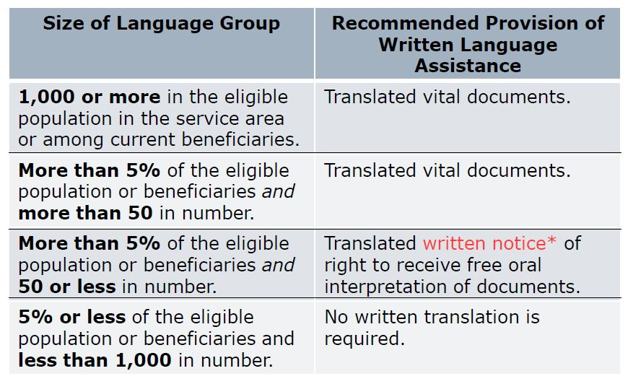
Compliance
Safe Harbor for written translations:
Notes:
*In the primary language of the LEP language group

Slide 21
Compliance
Environmental Justice
Executive Order 12898, Federal Actions to Address Environmental Justice in Minority Populations and Low-Income Populations, addresses disproportionate adverse environmental, social and economic impacts that may exist in communities, specifically minority and low-income populations.
Notes:
Identifying, and addressing, as appropriate, disproportionately high and adverse human health and environmental effects of its programs, policies, and activities on minority populations and low income populations
To ensure the full and fair participation by all potentially affected communities in the transportation decision making process.
To prevent the denial of, reduction in, or significant delay in the receipt of benefits by minority and low-income populations.

Slide 22
Noncompliance
If a recipient is found to be noncompliant by FHWA the following sanctions can occur:
Federal informal action
Federal corrective action plan
Federal funding termination
Federal government can terminate funding for actual or threatened non-compliance

Slide 23
Noncompliance
If the sub-recipient is found to be noncompliant by KYTC the following sanctions can occur:
State informal action
State corrective action plan
Financial penalties for “responsible entities”
Withhold funding
Termination or suspension of the contract/grant in whole or in part

